Slide 1
COMPUTATIONAL PHYSICS
GROUP-5

Slide 2
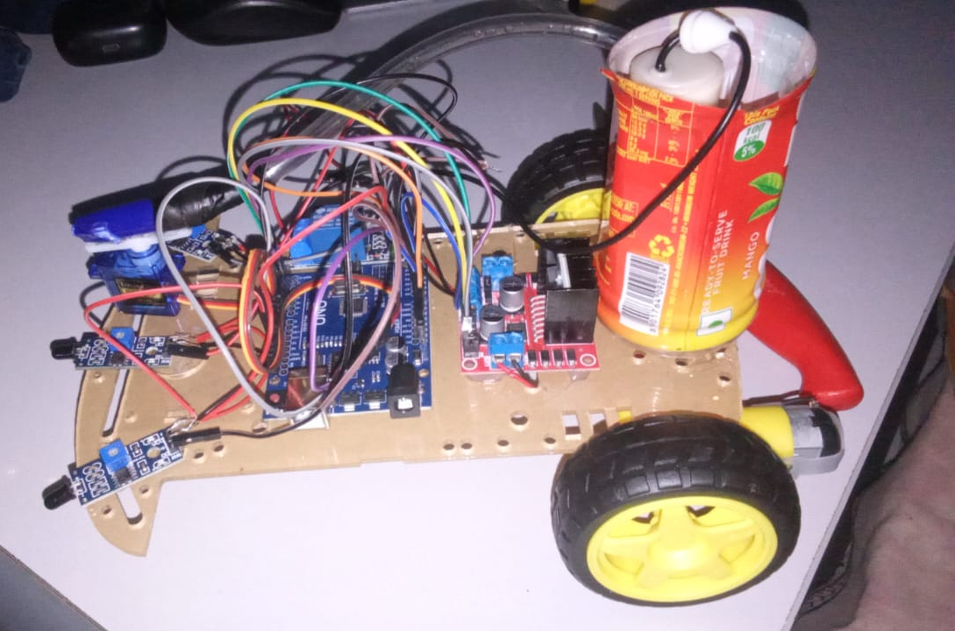
FIRE FIGHTING ROBOT

Slide 3
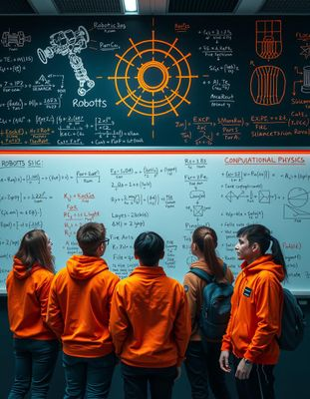
TEAM MEMBERS
Gadiraju Chaitanya Varma – cb.sc.u4aie24017
Hanumandla Harshith Reddy - cb.sc.u4aie24018​
Jishnu Teja Dandamudi – cb.sc.u4aie24019
​
Jivites Damodar –
cb.sc.u4aie24020

Slide 4
ABSTRACT
The problem definition for a firefighting robot is to develop a robot which accurately tries to detect a flame or fire nearby and move to that place if an only if there is no obstacle for it to move. The robot must also be able to detect multiple fires at the same time. There is no controller for the robot. The robot moves as fast as it can move to the nearby detected fire and cuts off the fire. The objective of this project is to design and develop an autonomous firefighting robot capable of detecting, locating, and extinguishing fires in various environments. The robot should operate in a range of settings, including indoor spaces, outdoor areas, and potentially hazardous environments that are difficult for human firefighters to navigate.

Slide 5
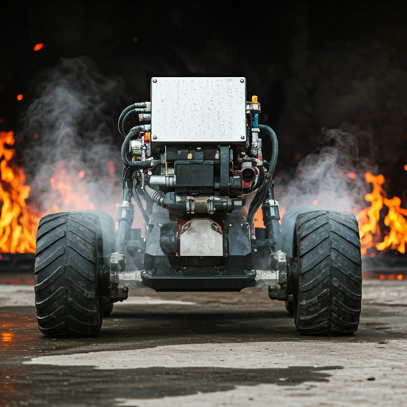
INTRODUCTION
This study includes an ARDUINO C++ programming code for performing the movement of the robot and extinguishing the fire detected. The code allows the free movement of the robot until it extinguishes the fire and manually stopped by the user, it will try to detect the fires nearby. It even detects any flames nearby and sprays water.

Slide 6
KEY REQUIREMENTS to be satisfied
Fire Detection
01
Autonomy
02
The robot is equipped with smoke sensors to accurately identify the presence and intensity of fire.​
The robot operates autonomously, making real-time decisions based on environmental conditions and fire locations.​
Mobility
03
The robot can navigate diverse terrains (e.g., stairs, uneven surfaces) using suitable locomotion methods (wheels, tracks, or legs).​
04
Power Supply
The design incorporates a reliable and sufficient power source to ensure extended operation during emergencies
Extinguishing Mechanism
05
The robot can effectively fires using extinguishater

Slide 7
GOALS
Step 03
Step 02
Step 01
Provide documentation and recommendations for future improvements and potential real-world applications.
Test and evaluate the robot’s performance in various scenarios to refine its capabilities.
Develop a prototype that successfully detects and extinguishes a fire in a controlled environment.​

Slide 8
COMPONENTS REQUIRED
5V 1 channel relay module compatible with 5V microcontroller (x 1 )​
DIY Mini Tubewell Kit(water Pump, Push Connector, Pipe, Battery Holder) starter Kit ( x 1 )​
Single core wires ( x 1 )​
Smart Motor Robot Car Battery Box Chassis Kit DIY Speed Encoder for Arduino ( x 1 )​
L298 Motor Driver Module ( x 1 )​
Flame Sensor Module Detector For Temperature Detecting ( x 3 )​
SG90 Micro Digital Servo Motor 9G for Robot Controls ( x 1 )

Slide 9
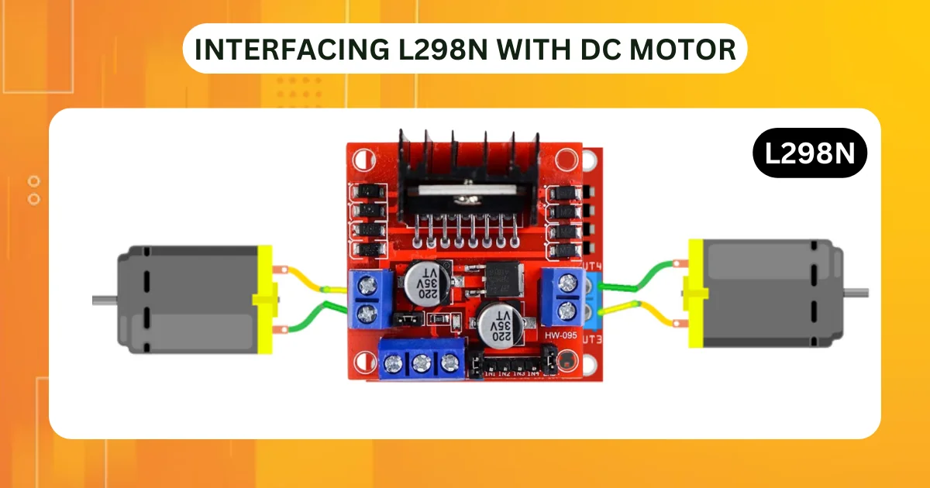
L298 MOTAR DRIVER MODULE
The L298N is a dual H-Bridge motor driver which allows speed and direction control of two DC motors at the same time.
This motor driver is one of the cheapest and the easiest way to control DC motors. One more advantage is that it can control a stepper motor as well.

Slide 10
SG90 Micro Digital Servo Motor 9G
The SG90 servo is a small, affordable servo motor commonly used in robotics, DIY projects, and educational applications. It is lightweight and low-cost with plastic gears for applications where minimal torque is required.
The water pump is connected to the battery. The water pump's hose is attached to the servo motor which rotates it in the direction of the burning fire. The pump then sprays water filled in the tank with which it is connected to put out the fire.

Slide 11
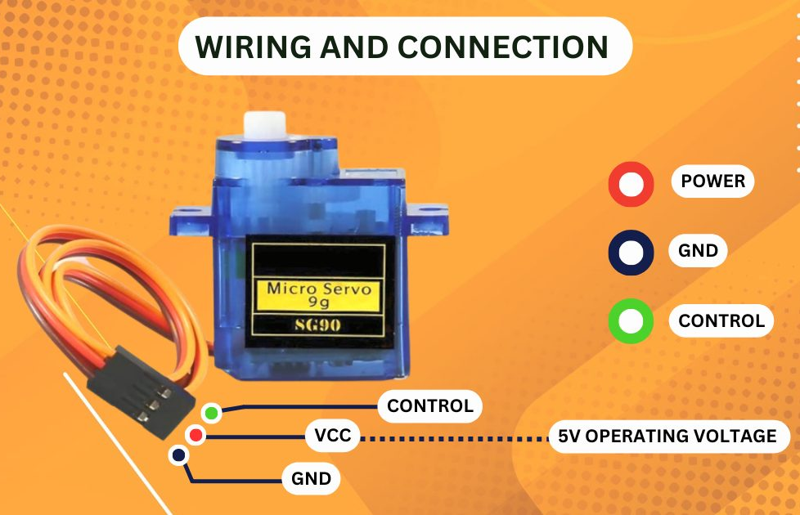
IMAGE OF SG90 Micro Digital Servo Motor 9G

Slide 12
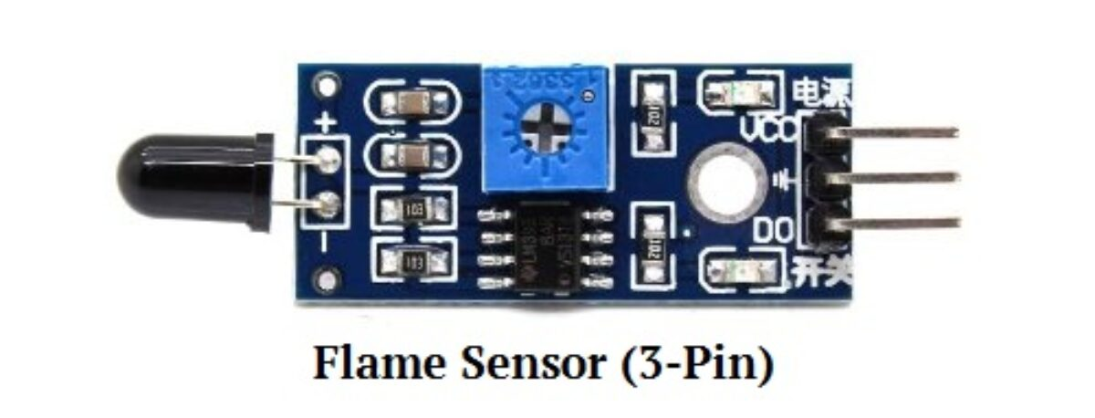
Flame Sensor
A flame-sensor is one kind of detector which is mainly designed for detecting as well as responding to the occurrence of a fire or flame.
We are using 3 sensors in our project.

Slide 13
Arduino UNO
Arduino UNO is based on an ATmega328P microcontroller. It is easy to use compared to other boards, such as the Arduino Mega board, etc. The board consists of digital and analog Input/Output pins (I/O), shields, and other circuits.
The Arduino UNO includes 6 analog pin inputs, 14 digital pins, a USB connector, a power jack, and an ICSP (In-Circuit Serial Programming) header.
The USB port in the Arduino board is used to connect the board to the computer using the USB cable.
Aurdino Uno is coded with Embedded c language
Notes:
Welcome back to Techatronic. I think all you have heard about the fire fighting Vehicle. This time we are going to make an advanced fire fighting vehicle which is also a robot and we called it a Fire fighter Robot. It is simply a machine that works automatically that’s why we called it a robot. We made this robot like it will go near to the fire and start its work. The fire fighter robot is very impressive and can be used in place of a vehicle.

Slide 14
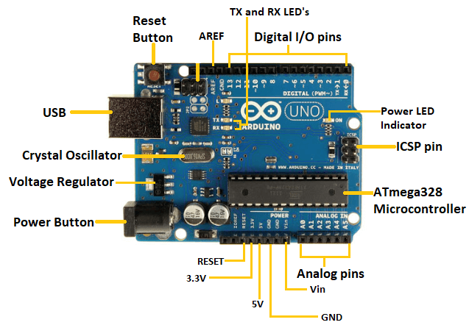

Slide 15
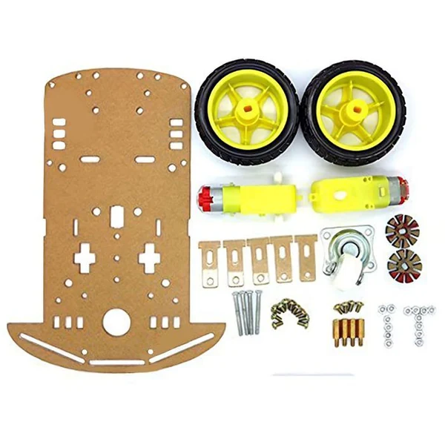
Basic Tools
Package Includes:
1 x Car chassis
2 x Wheels
1 x Castor wheel
2 x BO Motors
2 x Speed encoders
1 x Battery holder
All necessary screw and nuts.

Slide 16
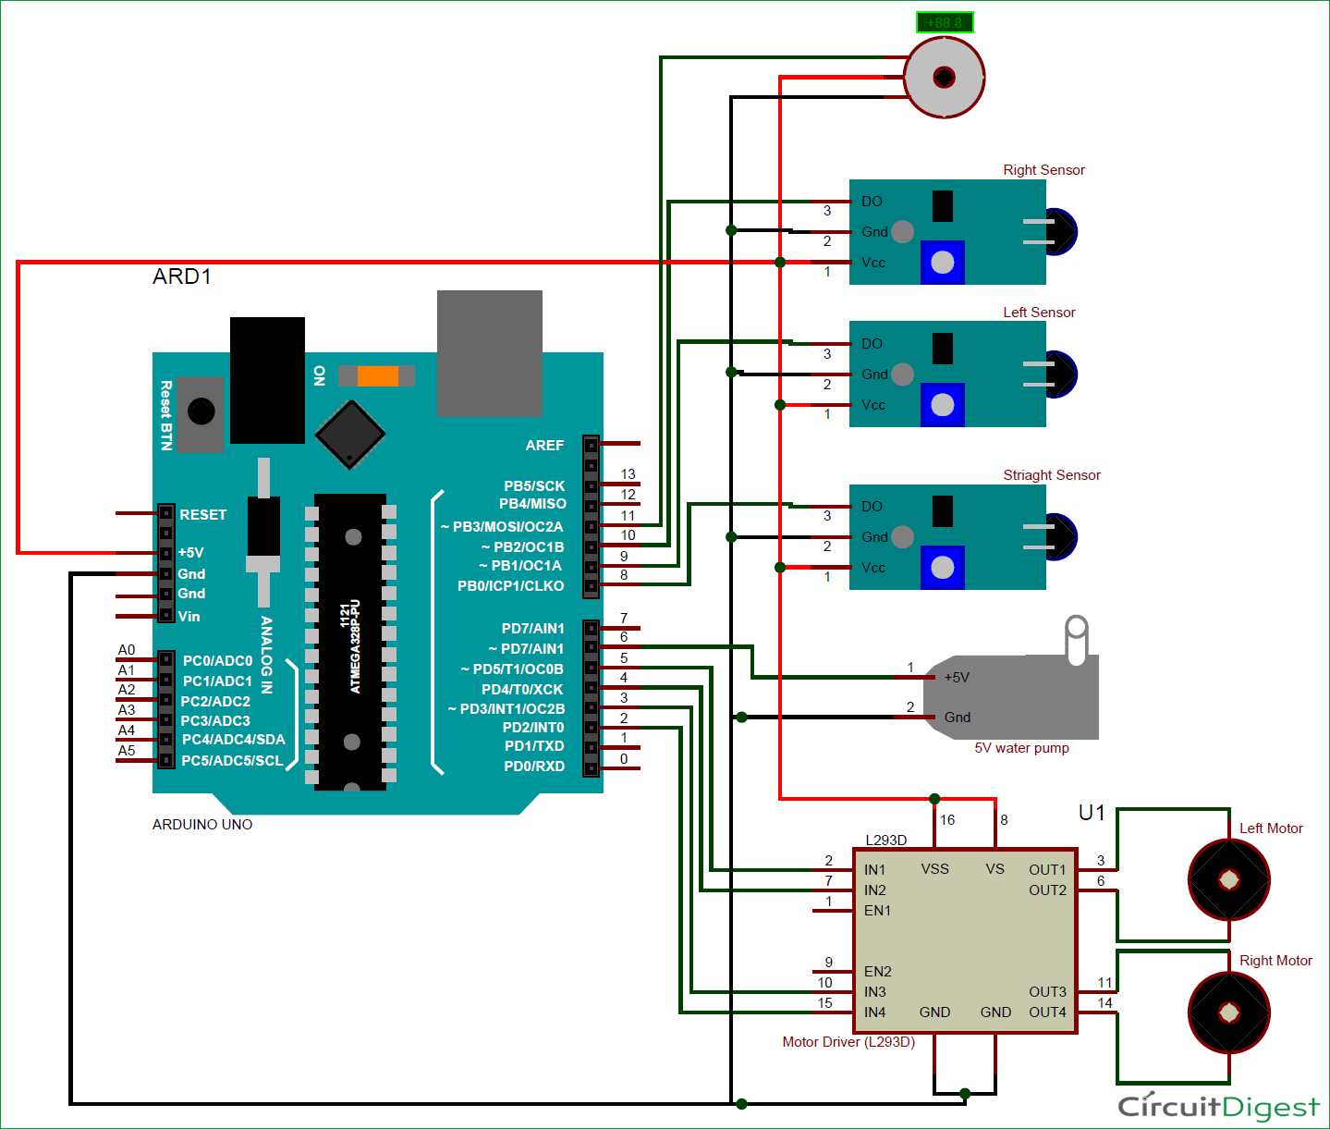
Circuit diagram

Slide 17
Explanation of the circuit diagram
POWER SUPPLY FOR MICRO CONTROLLER
As micro controller (aurdino uno) will act as brain of the robot it needs a power supply
Power Source: The microcontroller will be powered by the battery from the DIY Mini Tubewell Kit. Ensure the voltage is within the microcontroller’s operating range (e.g., 5V for Arduino).

Slide 18
Flame Sensors connection
VCC: Connect the VCC pin of each flame sensor to the 5V pin of the microcontroller.
GND: Connect the GND pin of each flame sensor to the GND pin of the microcontroller.
Digital OUT: The flame sensor has a Analog output pin that will give a HIGH signal when fire (infrared light) is detected. Connect each sensor’s Analog OUT pin to a different Analog input pin on the microcontroller (A1,A2,A4)
The microcontroller will monitor these input pins to know which sensor has detected fire and in which direction to move the robot.

Slide 19
L298 Motor Driver (for Robot Movement) Connections
Power Input: Connect the battery's positive terminal to the 12V pin on the L298 motor driver, and the negative terminal to the GND pin of the motor driver.
Motor Connections: The two motors from the Smart Motor Robot Car Battery Box Chassis Kit will be connected to the Motor Output A and Motor Output B terminals of the L298 motor driver. Motor 1 (left) connects to OUT1 and OUT2 of the L298 module.
Motor 2 (right) connects to OUT3 and OUT4 of the L298 module.

Slide 20
Control Pins:
The L298 motor driver has input pins (IN1, IN2, IN3, and IN4) that will control the direction of each motor. Connect IN1 and IN2 to the microcontroller's digital pins ( D2 and D3) to control Motor 1 (left).
Connect IN3 and IN4 to other digital pins ( D4 and D5) to control Motor 2 (right).
The microcontroller will control these pins to move the robot forward, backward, or turn in the direction of the fire.

Slide 21
SG90 Servo Motor (for Directing Water) Connections
VCC: Connect the servo motor's VCC pin to the 5V pin of the microcontroller.
GND: Connect the GND pin of the servo motor to the GND pin of the microcontroller.
Signal Pin: Connect the Signal pin of the servo motor to a PWM-enabled pin of the microcontroller ( D11).
The servo motor will be controlled using PWM signals to change its angle. Based on where the fire is detected, the servo motor will adjust the direction of the water nozzle to aim the water pump.

Slide 22
5V Relay Module (for Water Pump Control) Connections
VCC: Connect the relay’s VCC pin to the 5V pin of the microcontroller.
GND: Connect the GND pin of the relay to the microcontroller’s GND
.Control Pin: Connect the relay’s control (signal) pin to a digital output pin of the microcontroller ( D6). This pin will activate the relay when fire is detected, allowing current to flow to the water pump.
Relay Output (NO and COM): The water pump from the DIY Mini Tubewell Kit is connected to the relay’s Normally Open (NO) and Common (COM) terminals. The relay will close the circuit and activate the water pump when it detects fire.

Slide 23
DIY Mini Tubewell Kit (Water Pump)Power Source: The water pump needs to be connected to the relay module, which controls when the water pump turns on. One terminal of the water pump will be connected to the NO terminal of the relay, and the other terminal will connect to the ground.
When the relay closes, the water pump will receive power and start pumping water.
Single Core Wires-These will be used for all the connections between the components, ensuring proper signal and power flow throughout the circuit.

Slide 24
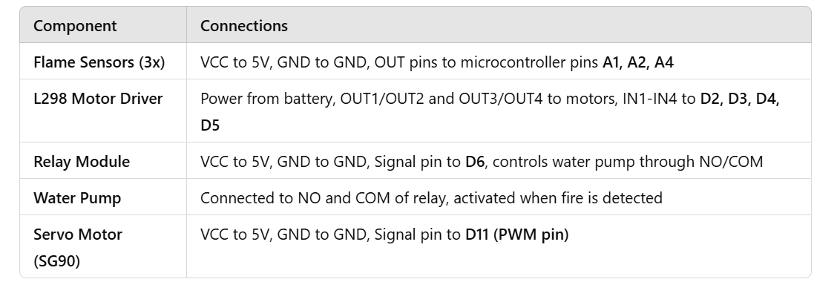
Summary of connections

Slide 25
Working Principle
Fire Detection: The flame sensors continuously monitor the surroundings. When any sensor detects fire, it sends a signal to the microcontroller.
Motor Control: Based on which sensor detects the fire, the microcontroller controls the motors (via the L298 Motor Driver) to move the robot toward the fire.
Fire Extinguishing: Once close to the fire, the microcontroller activates the relay, turning on the water pump.
The servo motor adjusts the direction of the water stream towards the detected fire.
Autonomous Navigation: The robot can be programmed to stop when the fire is extinguished or continue to search for other flames.

Slide 26
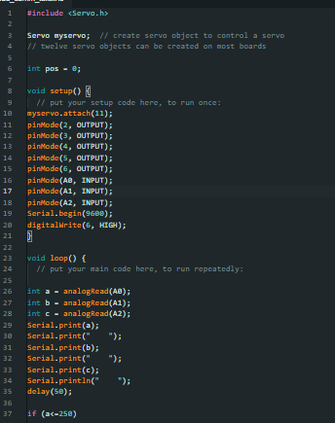
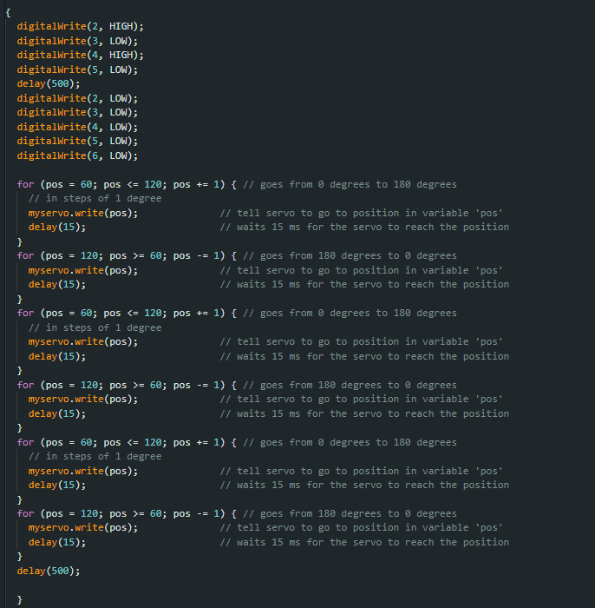
CODE

Slide 27

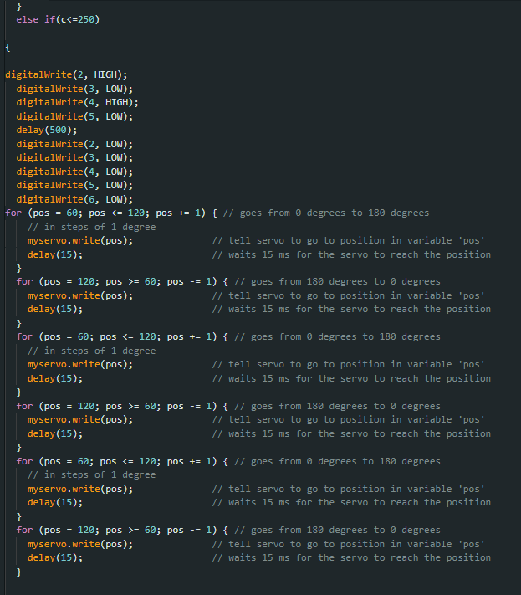

Slide 28



Slide 29
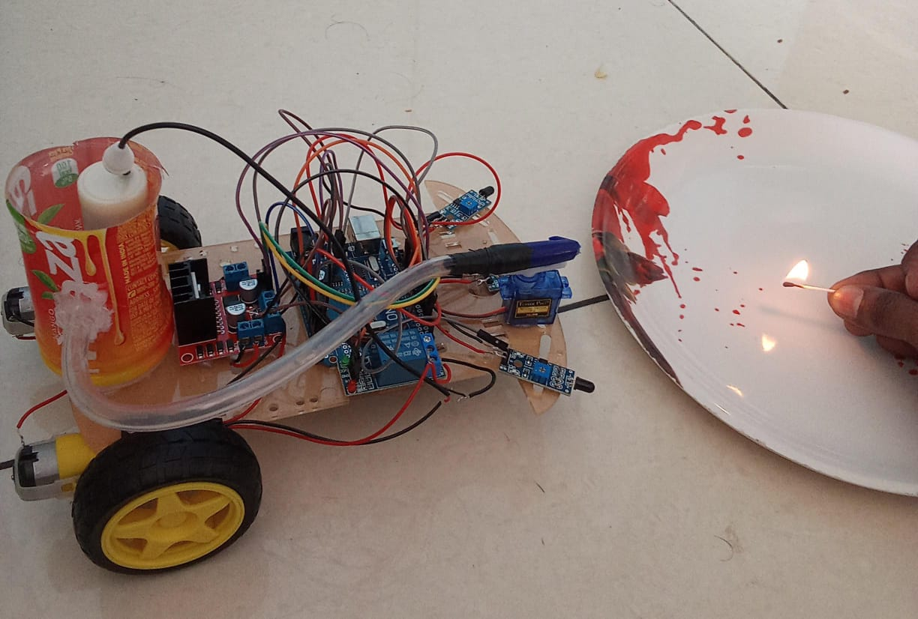

Slide 30
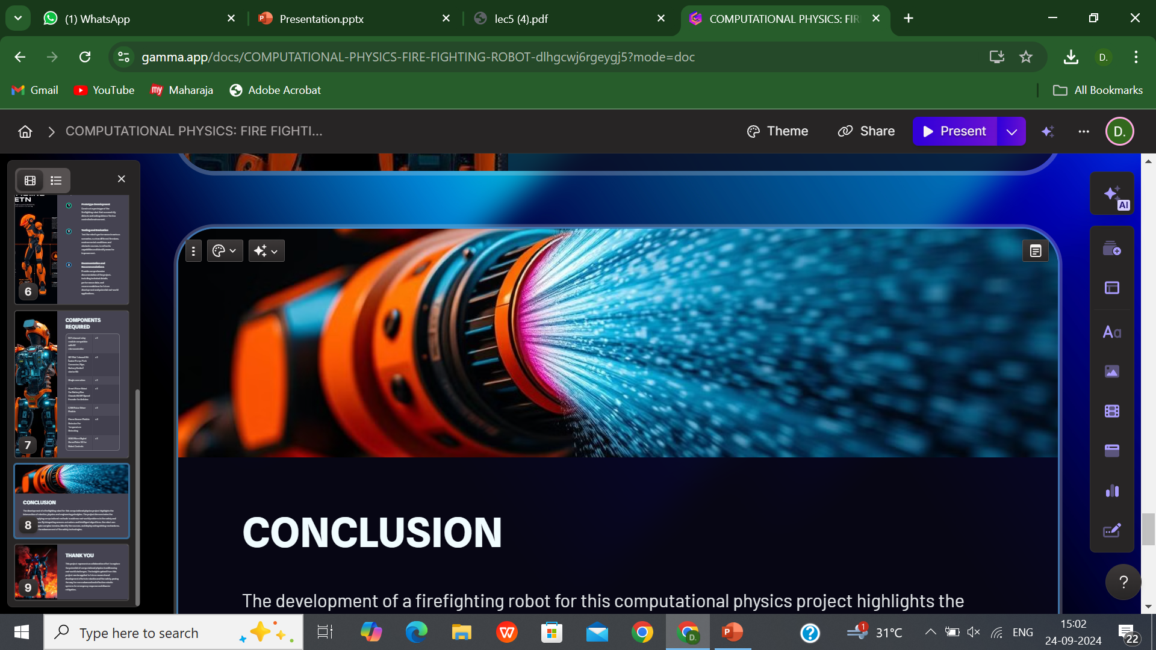
CONCLUSION
In conclusion, the development of a firefighting robot for our computational physics project demonstrates the significant intersection of robotics, physics, and engineering principles. Through our simulations and designs, we have effectively modeled the robot's dynamics, optimizing its performance in challenging environments. The integration of sensors for smoke detection and temperature measurement, alongside precise movement algorithms, highlights the potential for real-world applications in emergency response.​

Slide 31
Future work could involve enhancing the robot's autonomy and incorporating advanced AI for improved decision-making in complex scenarios. Ultimately, this project not only showcases the capabilities of computational physics in solving practical problems but also contributes to the ongoing efforts in improving fire safety and disaster response technologies. The insights gained here could pave the way for more sophisticated robotic systems in various fields, underscoring the importance of interdisciplinary collaboration in advancing technology for the greater good.​

Slide 32
THANK YOU!

